Slide 1
Deb Duay Workshop
By Valerie Phillips Gildehaus, Registrar, Daniel H. Brush Chapter NSDAR

Slide 2
Debbie Duay, Ph.D.
National Vice Chairman Lineage Research – French Task Force
FSSDAR CDRC Chairman & Volunteer Genealogists Chairman
debduav®yahoo.com
I attended her Workshop on Feb 22 in Georgia.
I ran into Daniel H Brush Past-Regent Marge Schulhof at the workshop.
Deb is a DAR member.
Lots of great research tips!!
Main web sites are on your handout, so you don’t have to write this down.

Slide 3
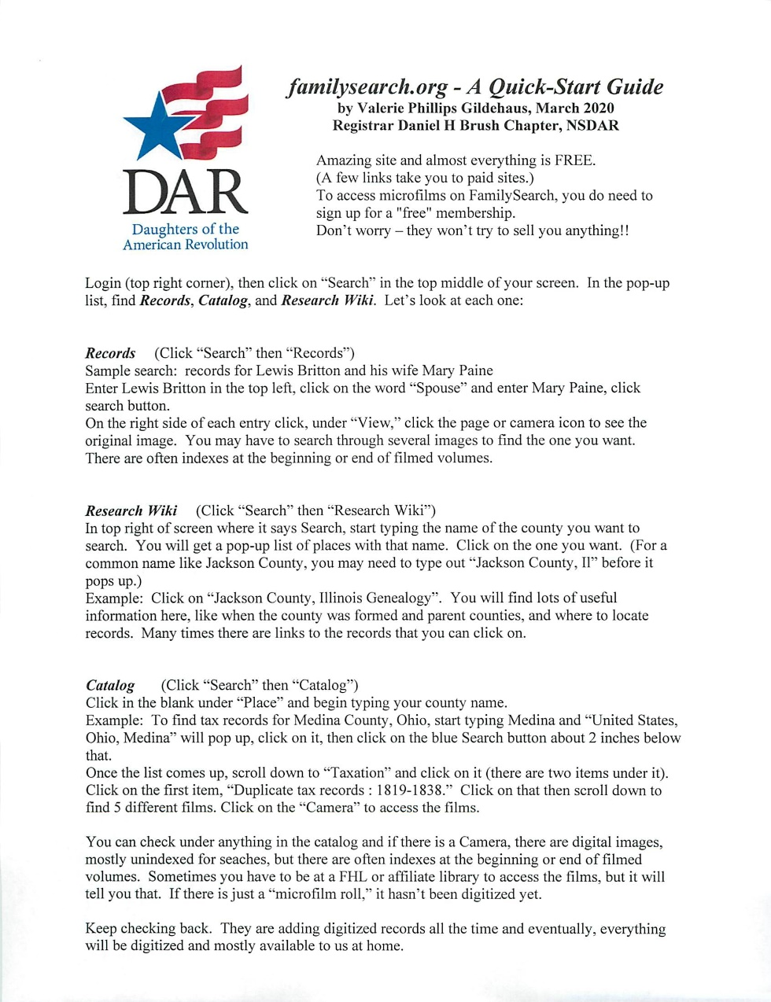
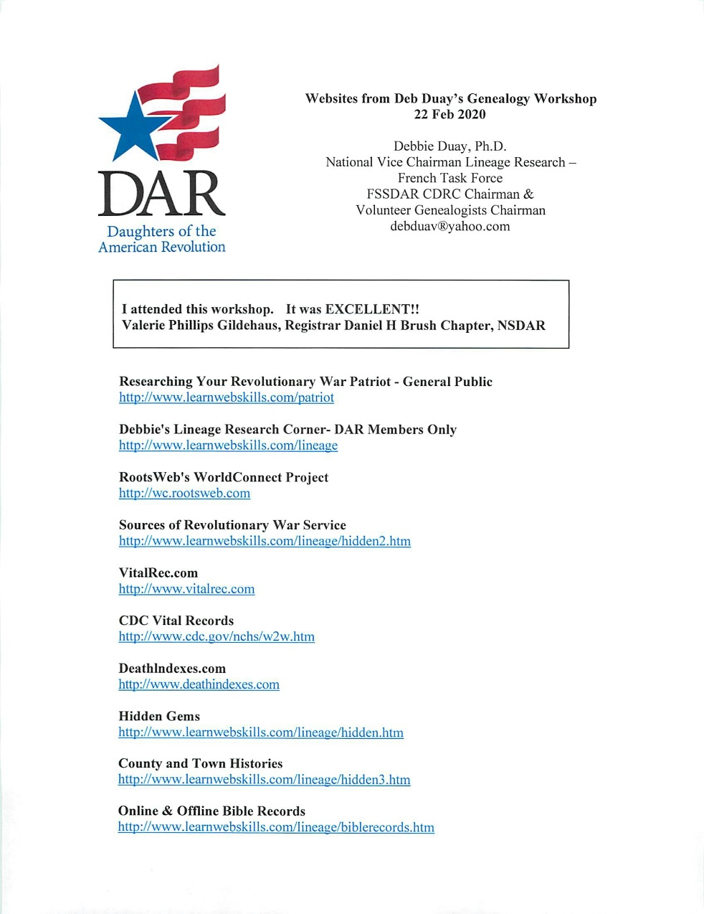
Two handouts – emailed to you by Jill

Slide 4
Deb Duay
Make sure you go to Deb’s site for DAR members only:
http://www.learnwebskills.com/lineage
You will not find it with a Google search.

Slide 5
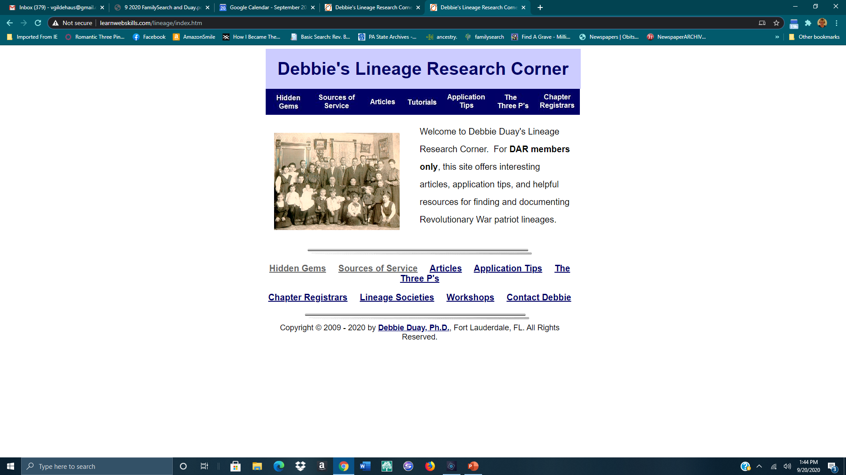
http://www.learnwebskills.com/lineage For DAR members only

Slide 6
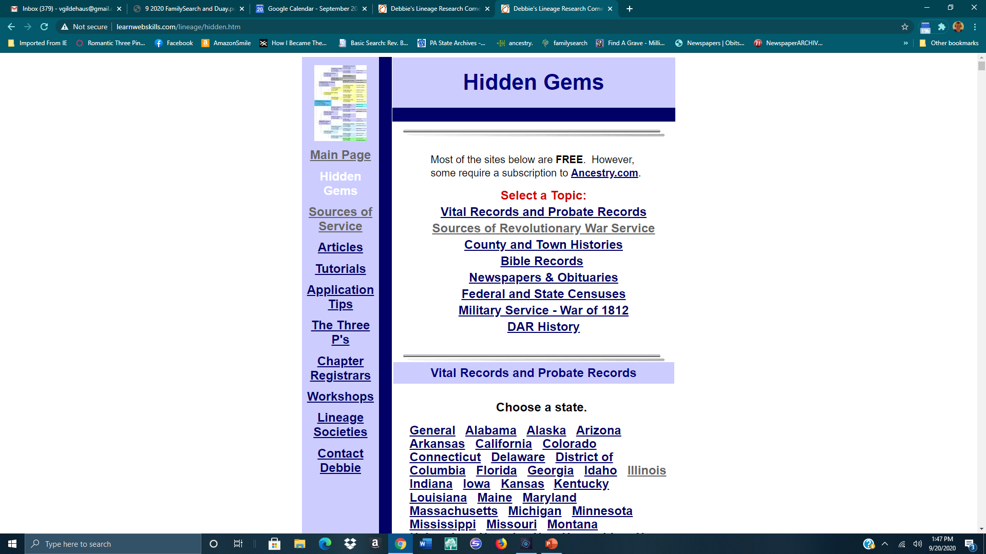
Hidden Gems – Scroll down to see State and Counties

Slide 7
Hidden Gems
Links to Ancestry & FamilySearch
All probate except Virginia are indexed
FamilySearch – All probates should be available by the end of 2020
Multiple volumes on same microfilm
There may be indexes at the beginning or end of each volume

Slide 8
Not all records are in the index.
Just because there is an index to a State’s Probate Records, does not mean that ALL records are indexed.
Many records that are “locked” on FamilySearch are available on Ancestry.
If your person does not appear on the index search through the individual county records.

Slide 9
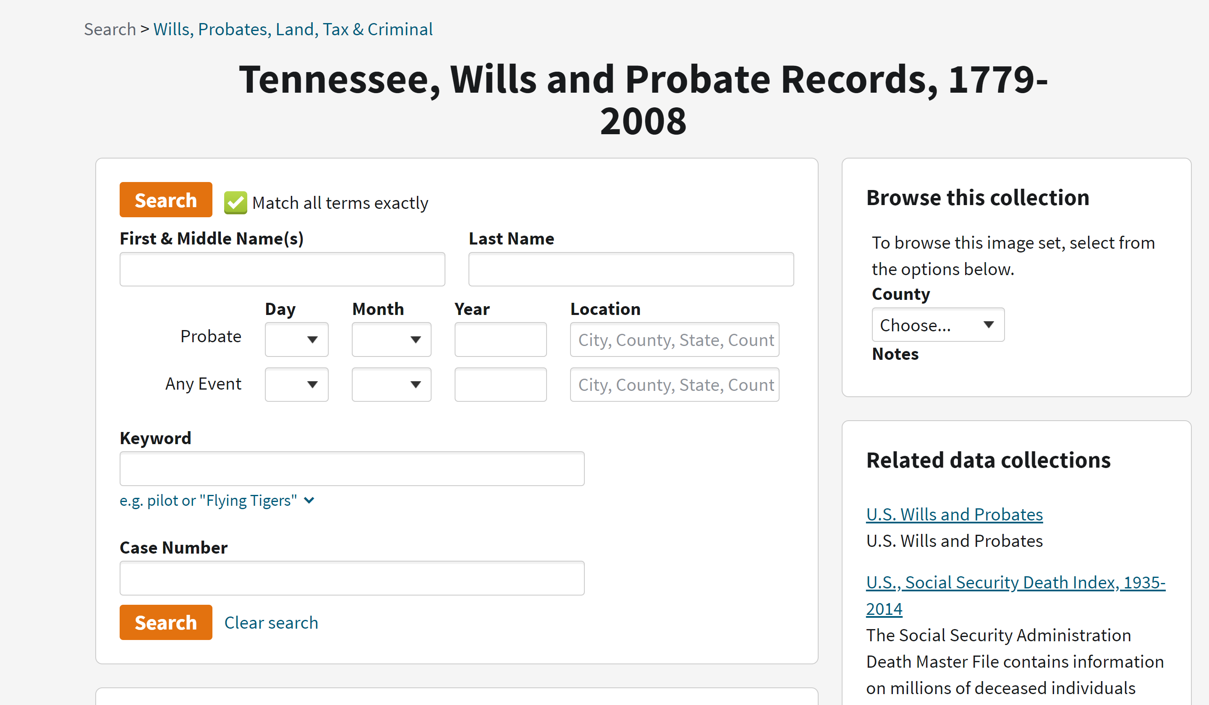
Click on the little down arrow to see what is available

Slide 10
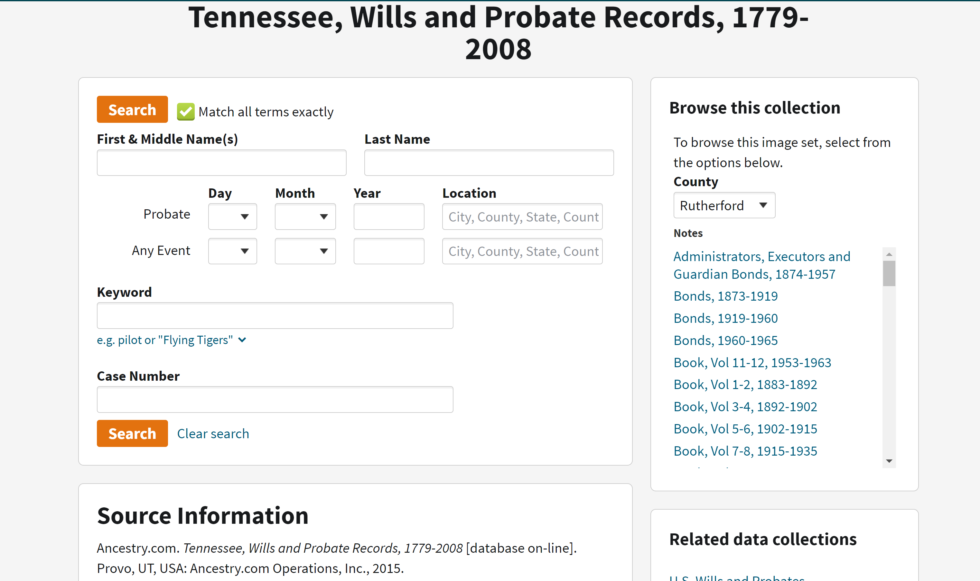
Pick the county, then scroll down to select the title

Slide 11
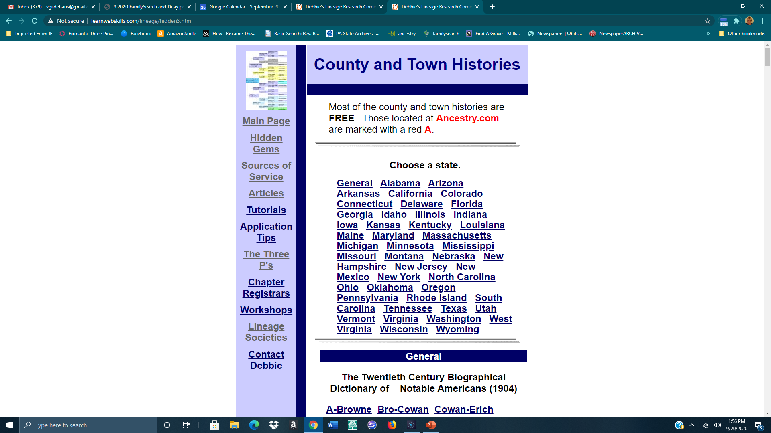
Hidden Gems – County and Town Histories

Slide 12
Hidden Gems – County and Town Histories

Slide 13
County and Town Histories are sometimes acceptable as a DAR Source
Considered on a case-by-case basis
Subject of the bio was alive when book was published
What would the subject of the bio have known about his family?
Find other records (census, land, marriage, probate) to support as much of the bio as possible
Use to prove parents and grandparents of subject
Check for bios of brothers and sisters, too!

Slide 14
Using wildcards * and ? in searches
Can be used in Ancestry, Google, Fold3, and other searches.
Use wildcards at beginning, middle, or end of the name/word
* - Replaces up to 3 letters
? – represents one letter - use a question mark to search for Joiner and Joyner at the same time: Jo?ner
Looking for Gustin, formerly Augustin - use *gustin
Use in Card Catalogue to save time: Revolutionary War Pensions – type Rev* War Pens* Massachusetts Death Records – type Massa* Death*

Slide 15
FamilySearch.org
This is an amazing site but is not very user-friendly.
The handout is a Quick-Start guide to help you with the basics of FamilySearch. Work through the handout, and you should have a better idea of how to navigate on FamilySearch.
New material is added every day, so check back frequently.

Slide 16
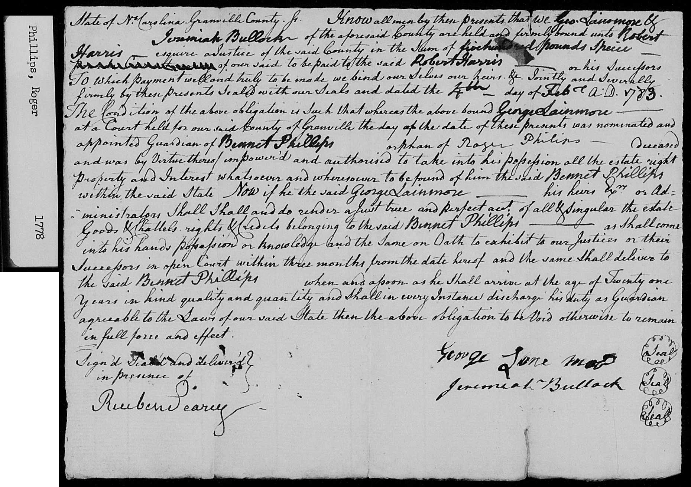
Guardianship of Bennet Phillips, orphan of Roger Phillips Granville County NC 1783 – an example of what you can find on FamilySearch.

Slide 17
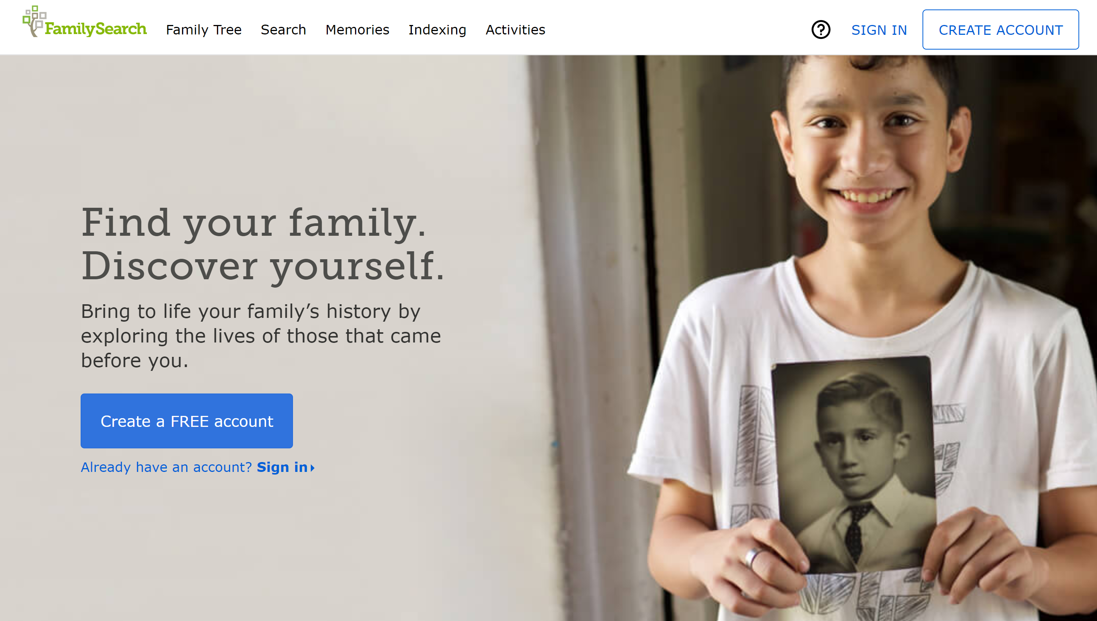
FamilySearch
Sign up for a free account the first time, then log in

Slide 18
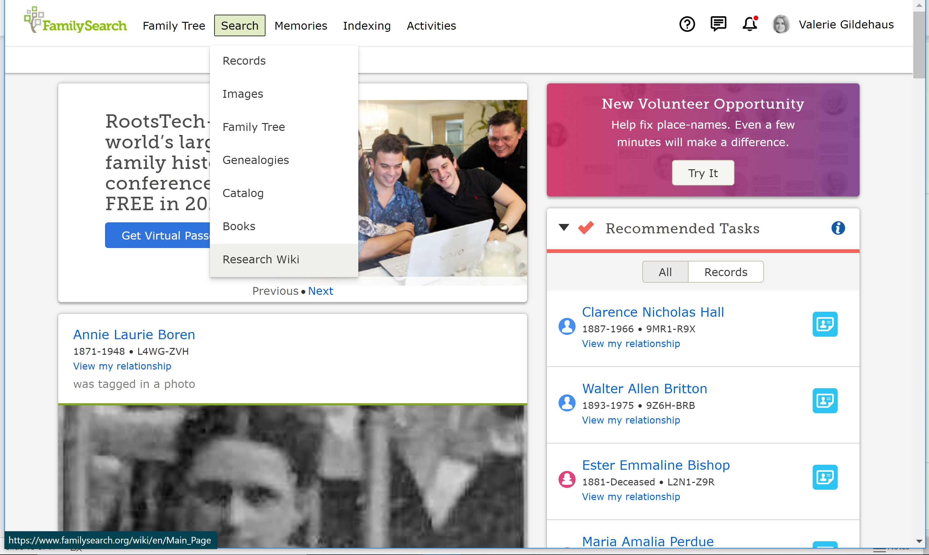
Click on Search, then Research Wiki

Slide 19
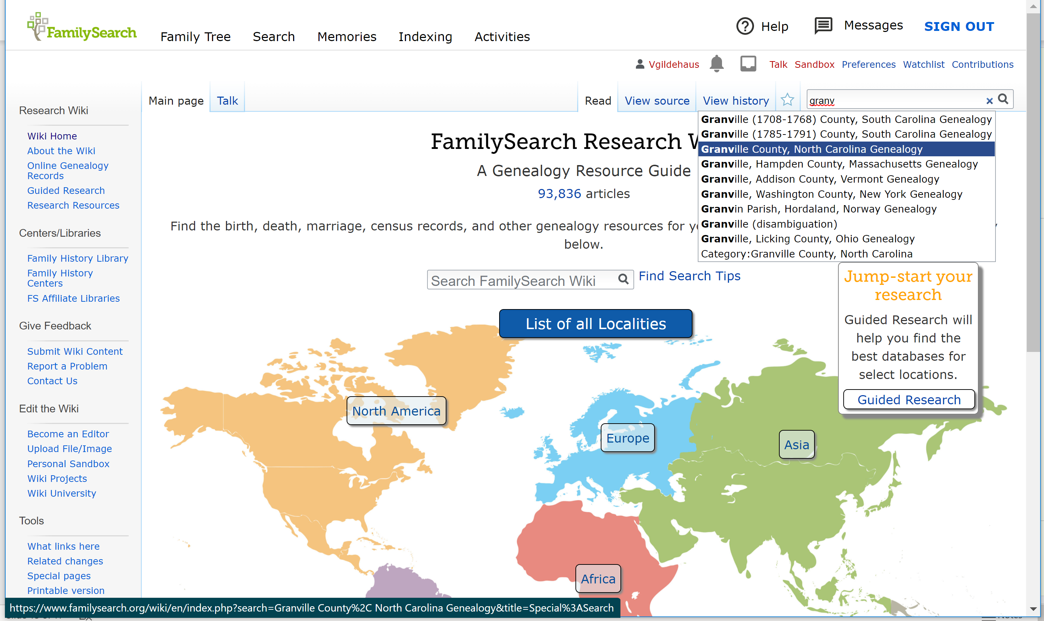
Start typing, then click on the pop-up list

Slide 20
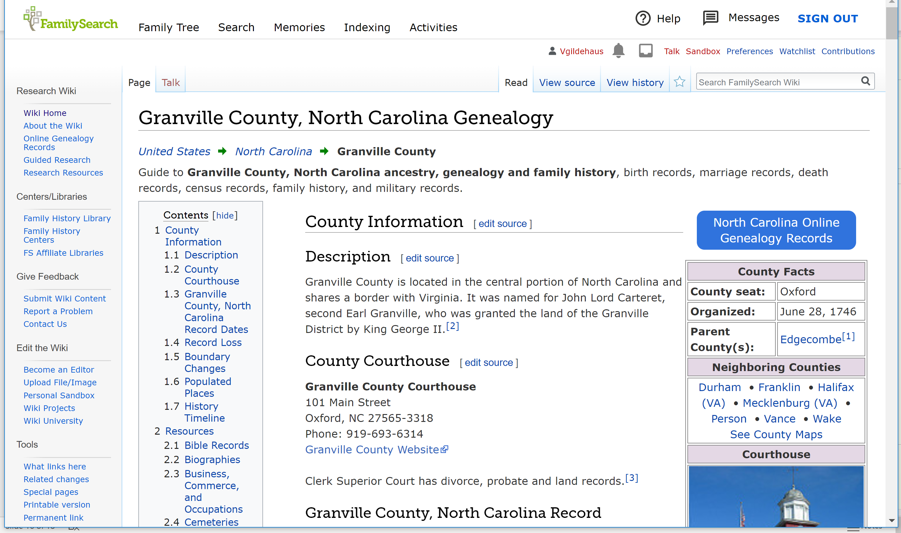
Scroll down and click on links for more

Slide 21
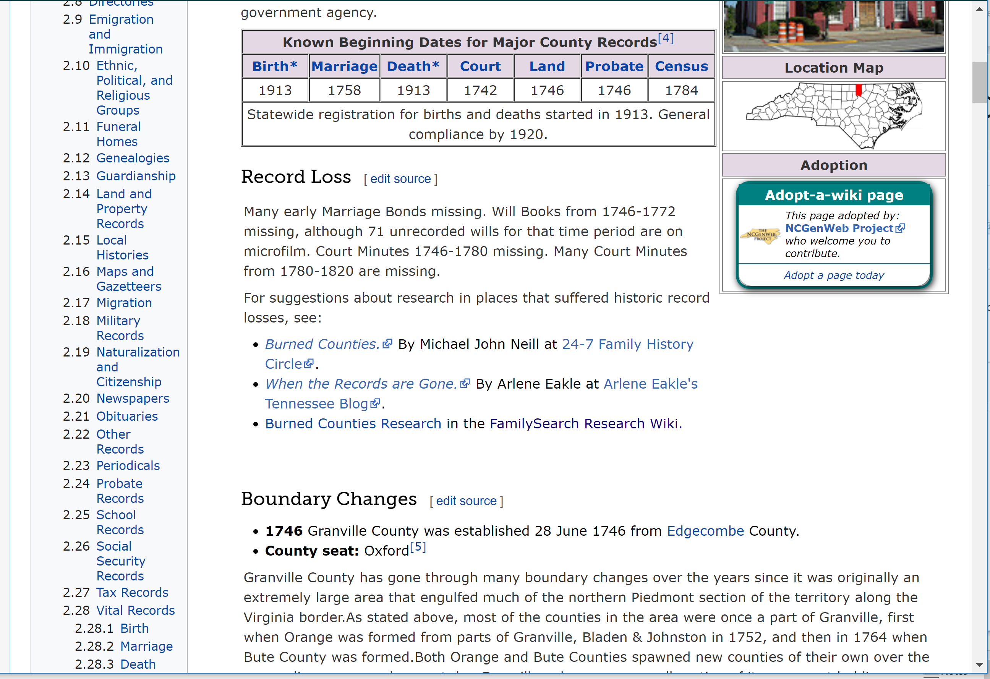
More Granville County

Slide 22
Research Wiki – pay attention to
Date of County formation
Boundary changes
Your ancestor may be listed in 3 or 4 different counties, but never have moved at all
Record losses
Long list of records and their sources
Anything that is blue typing is a link

Slide 23
Deb Duay - War of 1812
Pensions are a great source for those elusive children and grandchildren of our Patriots!!

Slide 24
War of 1812 – Check out Fold3 https://www.fold3.com/title/761/war-of-1812-pension-files
War of 1812 pensions are FREE
Available through the letter “S”
The rest coming soon
Search here

Slide 25
War of 1812 Bounty Land Applications are not included, but there is an index on Fold 3 – “War of 1812 Bounty-Land Warrant Applications” These can be ordered from the National Archives, when it opens again.

